Slide 1

REPUBLIC OF CAMEROUN
REPUBLIQUE DU CAMEROUN
Peace – Work - Fatherland
Paix – Travail - Paitre
Buea, South West Region
Buea, Sud Quest Region
P.O. Box 63
P.O. Box 63
University of Buea
FACULTY OF ENGINEERING AND TECHNOLOGY
Department of Computer Engineering
CEF599 : Internship
SCHOOL MANAGEMENT SYSTEM : ACADEMIA V2
By
NGWASIRI RYAN TANIFORM ONGA
FE21A266
Academic Supervisor
Prof Elie Fute
Technical Supervisor
Mr. Kofi Mokome

Slide 2
TABLE OF CONTENT
01
Introduction
05
Methodology & Architecture
02
Company Overview
06
Tasks Performed
03
Project Review
07
Challenges and Solutions
04
Development Diagrams
08
Conclusion

Slide 3

Introduction
01

Slide 4
What is Internship?
Internship provides a bridge between practical learning and professional application for working personnel.
This program allows personnel to apply theoretical knowledge in a professional setting, refine expertise, and prepare for future challenges in the work industry.

Slide 5






Details of Internship
Duration of Internship
Role Assigned
Frontend developer intern
7th June 2024 – 7th January 2024
6 months
Supervisors
Main Task
Academia V2
Mr. Kofi Mokome
Prof. Elie Fute

Slide 6

Company Overview
02

Slide 7






About Company
Here’s some info about Zinger Systems
Founders and CEOs
Mr. Valery Colong, Mr. Fua Tse
Web Development
Mobile App Development
Zinger Systems Limited is a full-fledged IT service provider with a focus on enterprise web and mobile solutions development.
DevOps
U/UX Design
Location
Besides 7 Days Adventist Hospital, Buea

Slide 8
Internship Activities
Meetings
Onsite meetings and Skype meetings held every week
Debugging and Testing
Coding sessions, reviews, and debugging
Reports
Reports given at the end of every week on standups
Design Discussions
Extra-curricular Activities
UI/UX design features were discussed for implementation
Activities like social gatherings, meetings, new-man tasks and Friday share

Slide 9


Project Review
03
Academia V2

Slide 10



What is Academia V2
Academia V2
Provides Statistical Data
A web-based school management system that digitalizes school processes with ease made by Zinger Systems Ltd
Provides statistical data such as reports and feedback.
Eases school management
Usage
Eases task automations such as enrollment and admission
Academia V1 is used by many secondary schools in the South West Region
Purposed Institutions
Task Automation
Primary, secondary and university institutions
Eases task automations such as enrollment

Slide 11




Academia V2 Functional Requirements
Administrative Control
User Management
User Authentication , User Management , Profile Management
Manage users roles.
Monitor and oversee academic and operational reports.
Create new programs, courses, and departments.
Attendance Tracking
View and report attendance records
Academic Structure Management
Institution Setup
Faculty Management
Department Management
Program Management
Course Management.
Reporting and Analytics
Generate reports on student performance, attendance, and enrollment.

Slide 12

















Academia V2 Tech Stack and Tools
Frontend
Backend
Tools

Slide 13

Development Diagrams
04

Slide 14
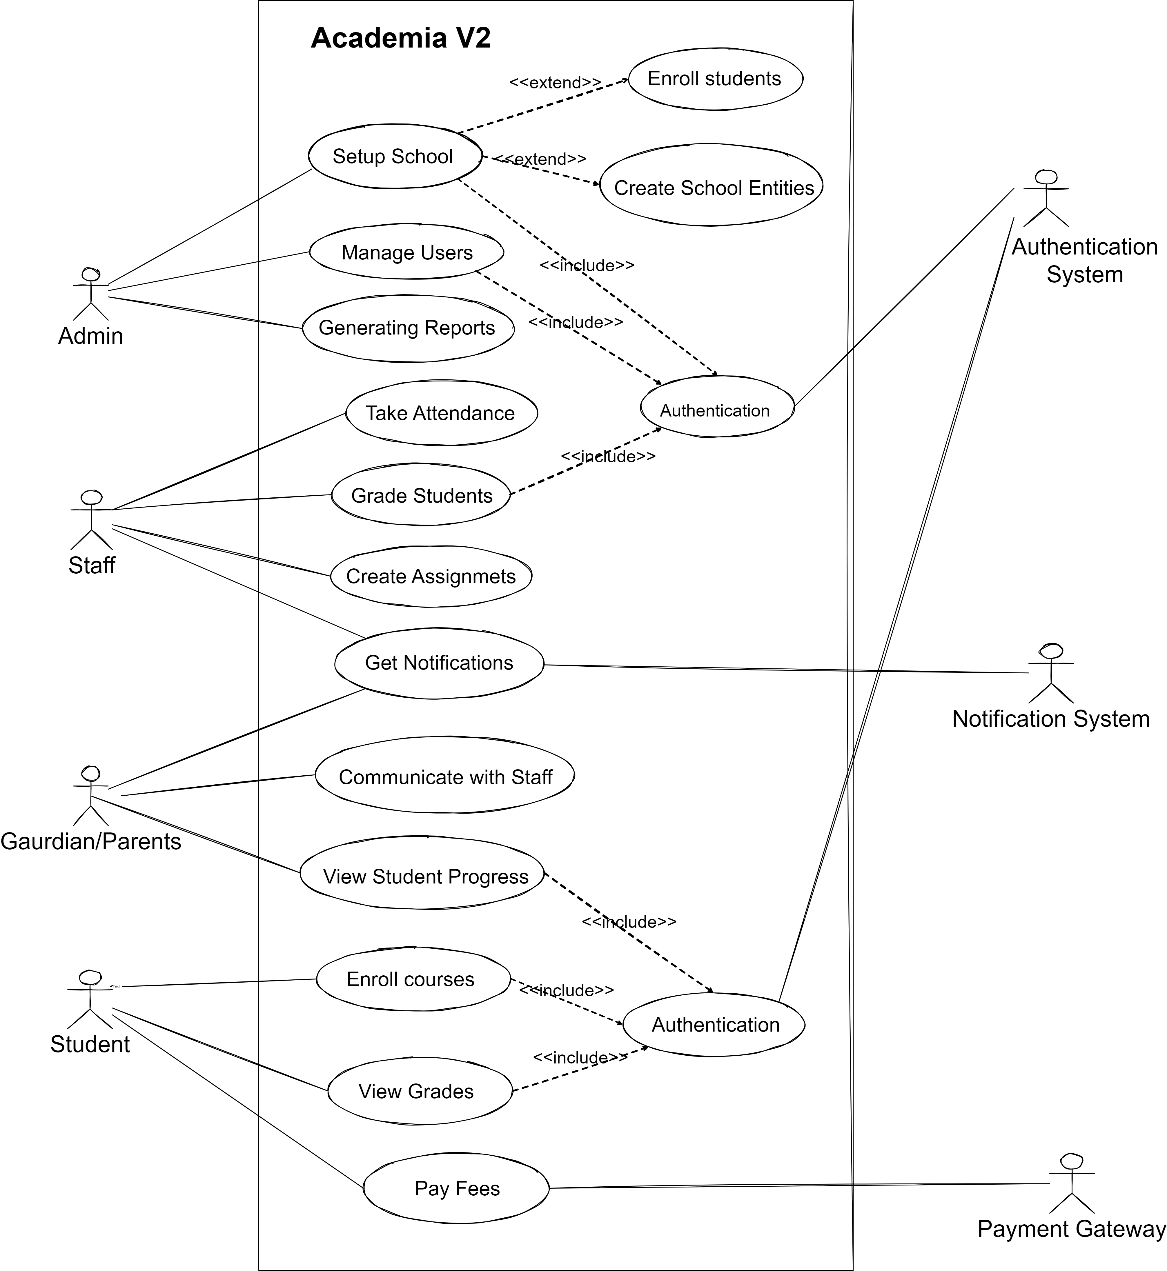
Use Case Diagram
Actors
Admins
Staff
Guardian
Student
Authentication System
Notification System
Payment Gateway
School Entities
Faculties
Departments
Programs
Courses
Classrooms
Academic Year
Semesters
Classes etc.

Slide 15
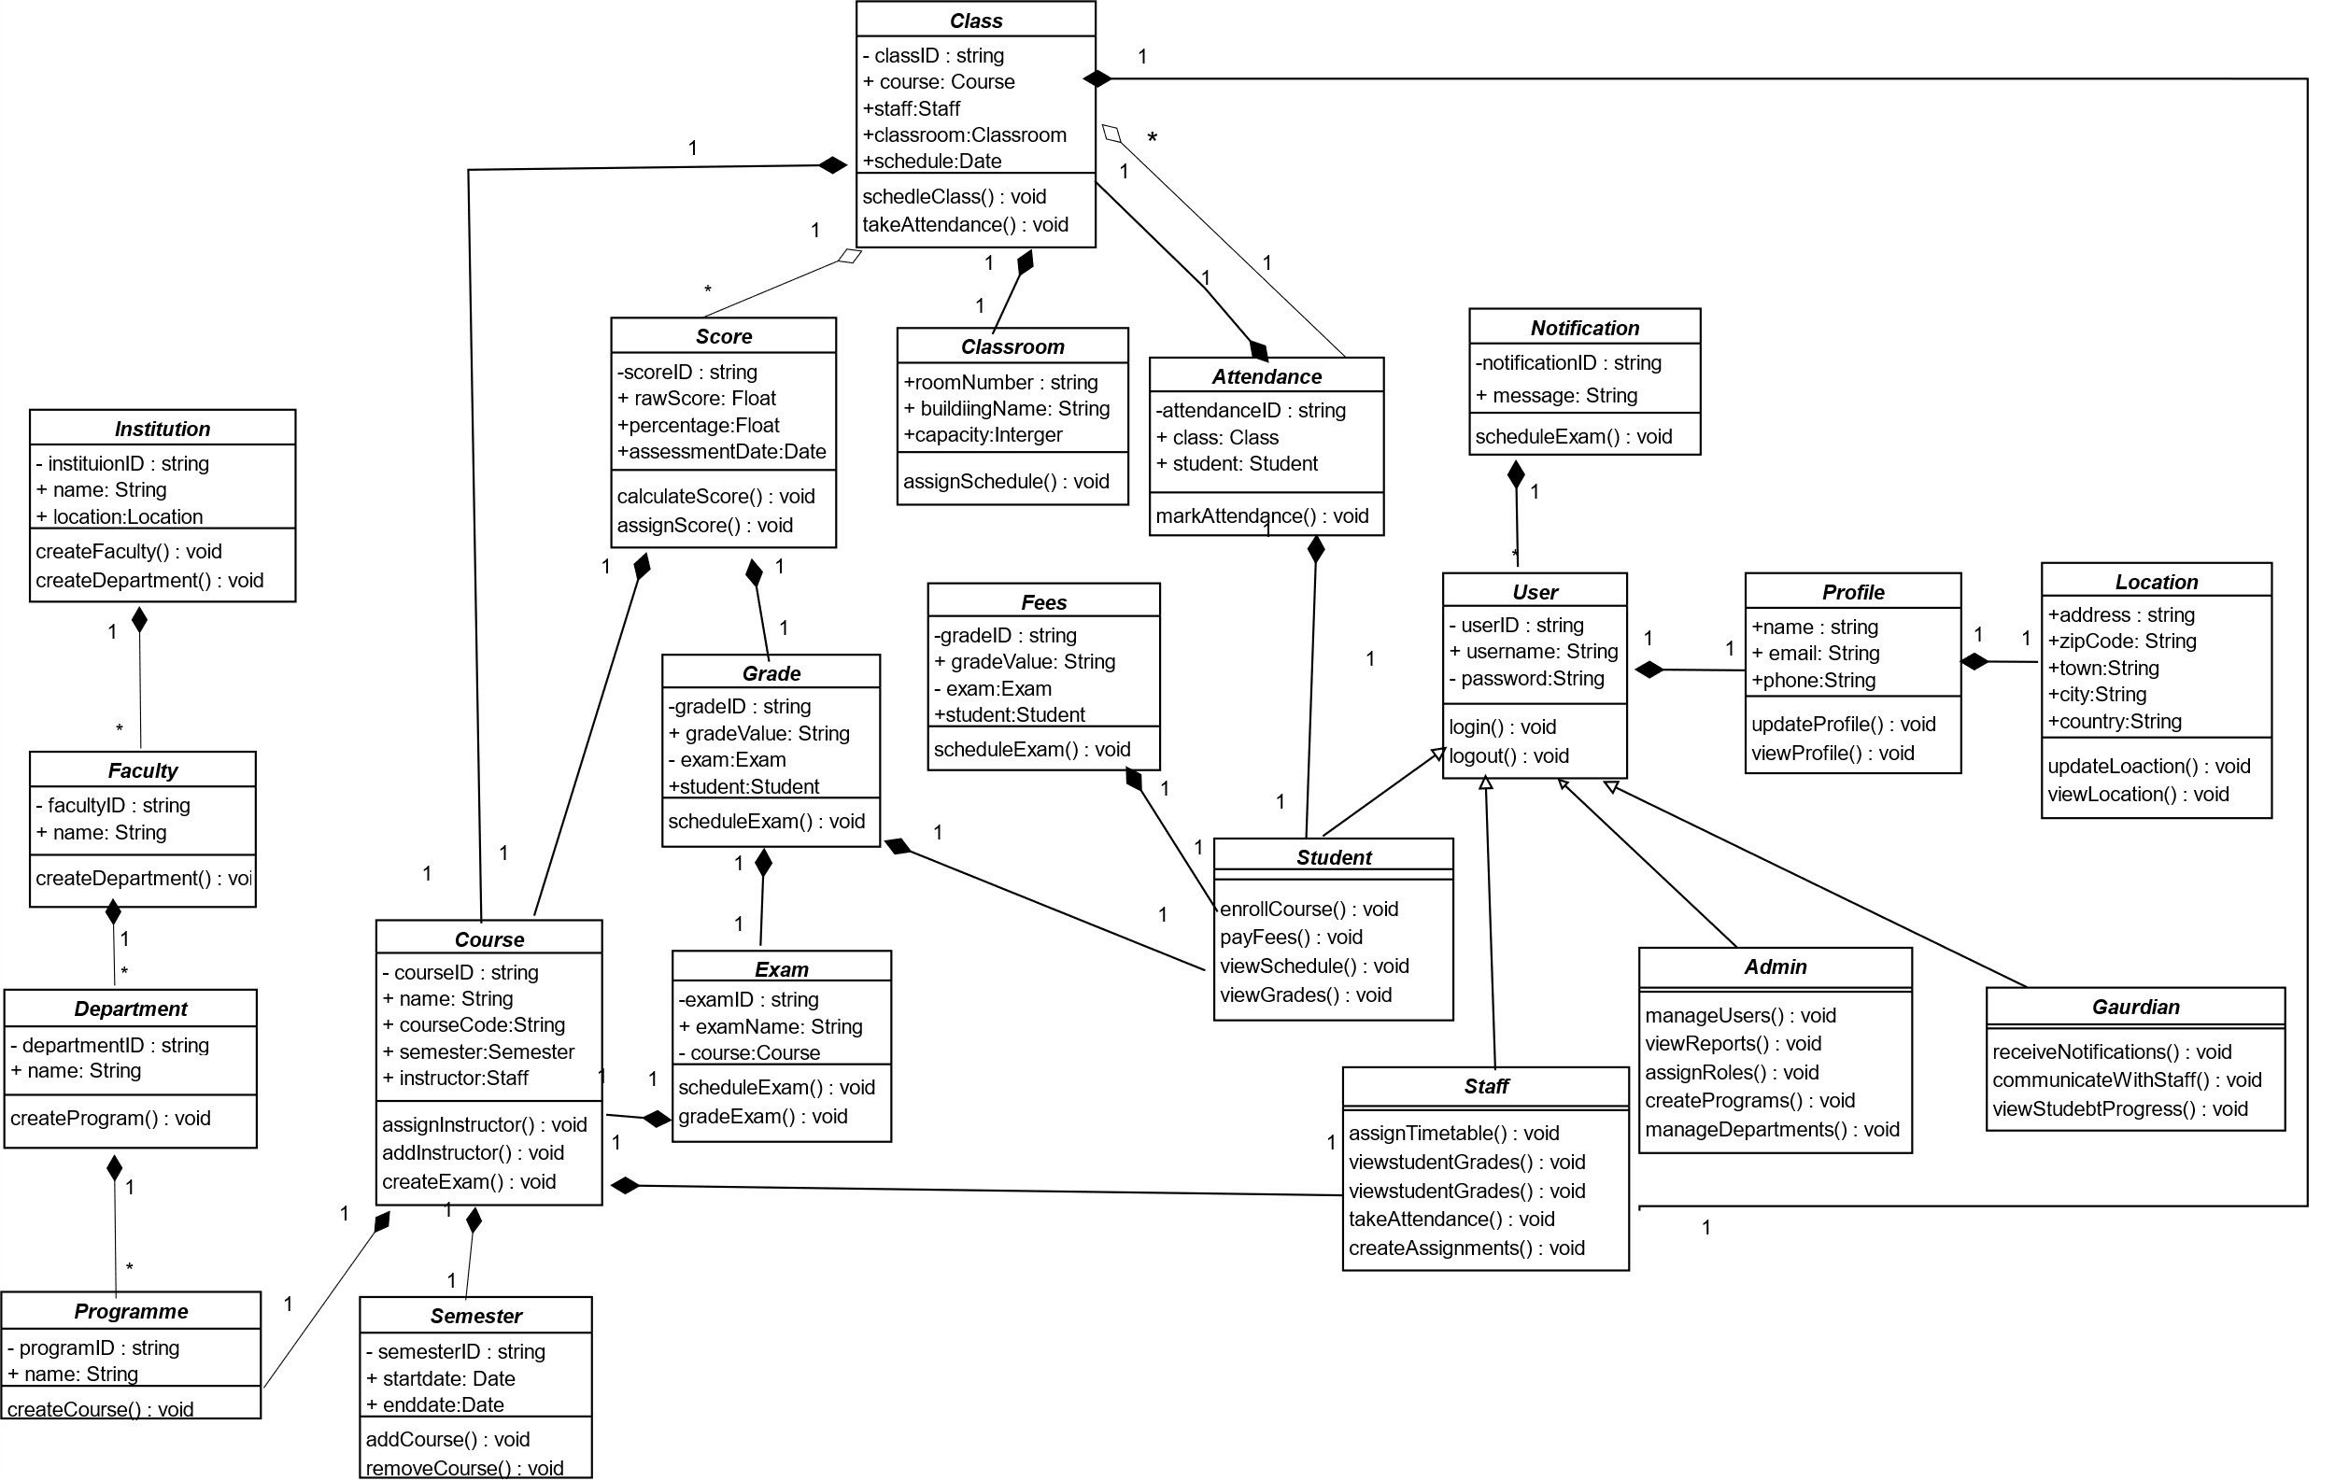
Class Diagram

Slide 16

Methodology & Architecture
05

Slide 17




Methodology
Architecture

Slide 18
ACADEMIA COLOR PALETS, BRANDING AND TYPOGRAPHY
#597ABD
Steel Blue
Aa
Calmness, trust, and professionalism
#FFFFFF
White
Merriweather Sans
Purity, simplicity , cleanliness and peace
#1E1E1E
Charcoal Black
Sophistication, elegance, and formality
#FFC107
Golden Yellow
ACADEMIA LOGO
Sophistication, elegance, and formality

Slide 19
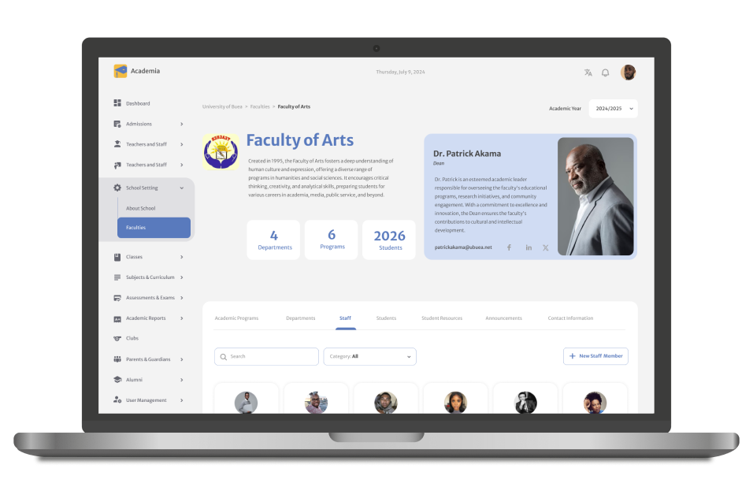

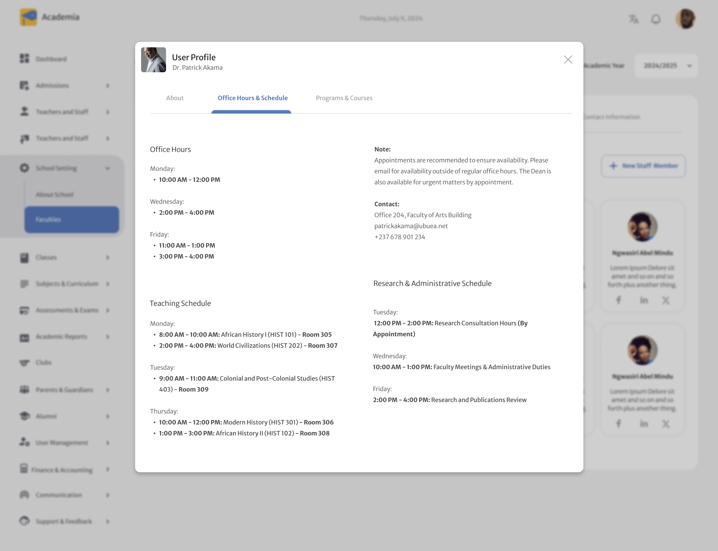
Faculty Detail Page and User Profile

Slide 20

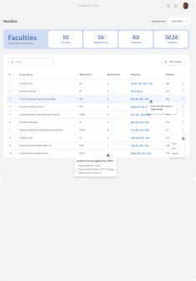
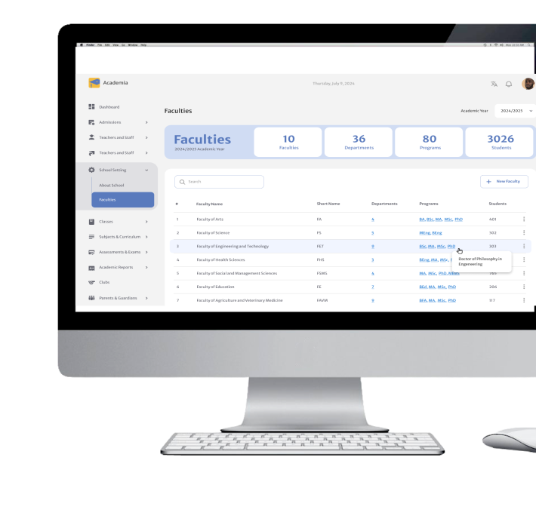

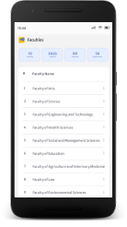
Faculty Listing Page in all Views

Slide 21
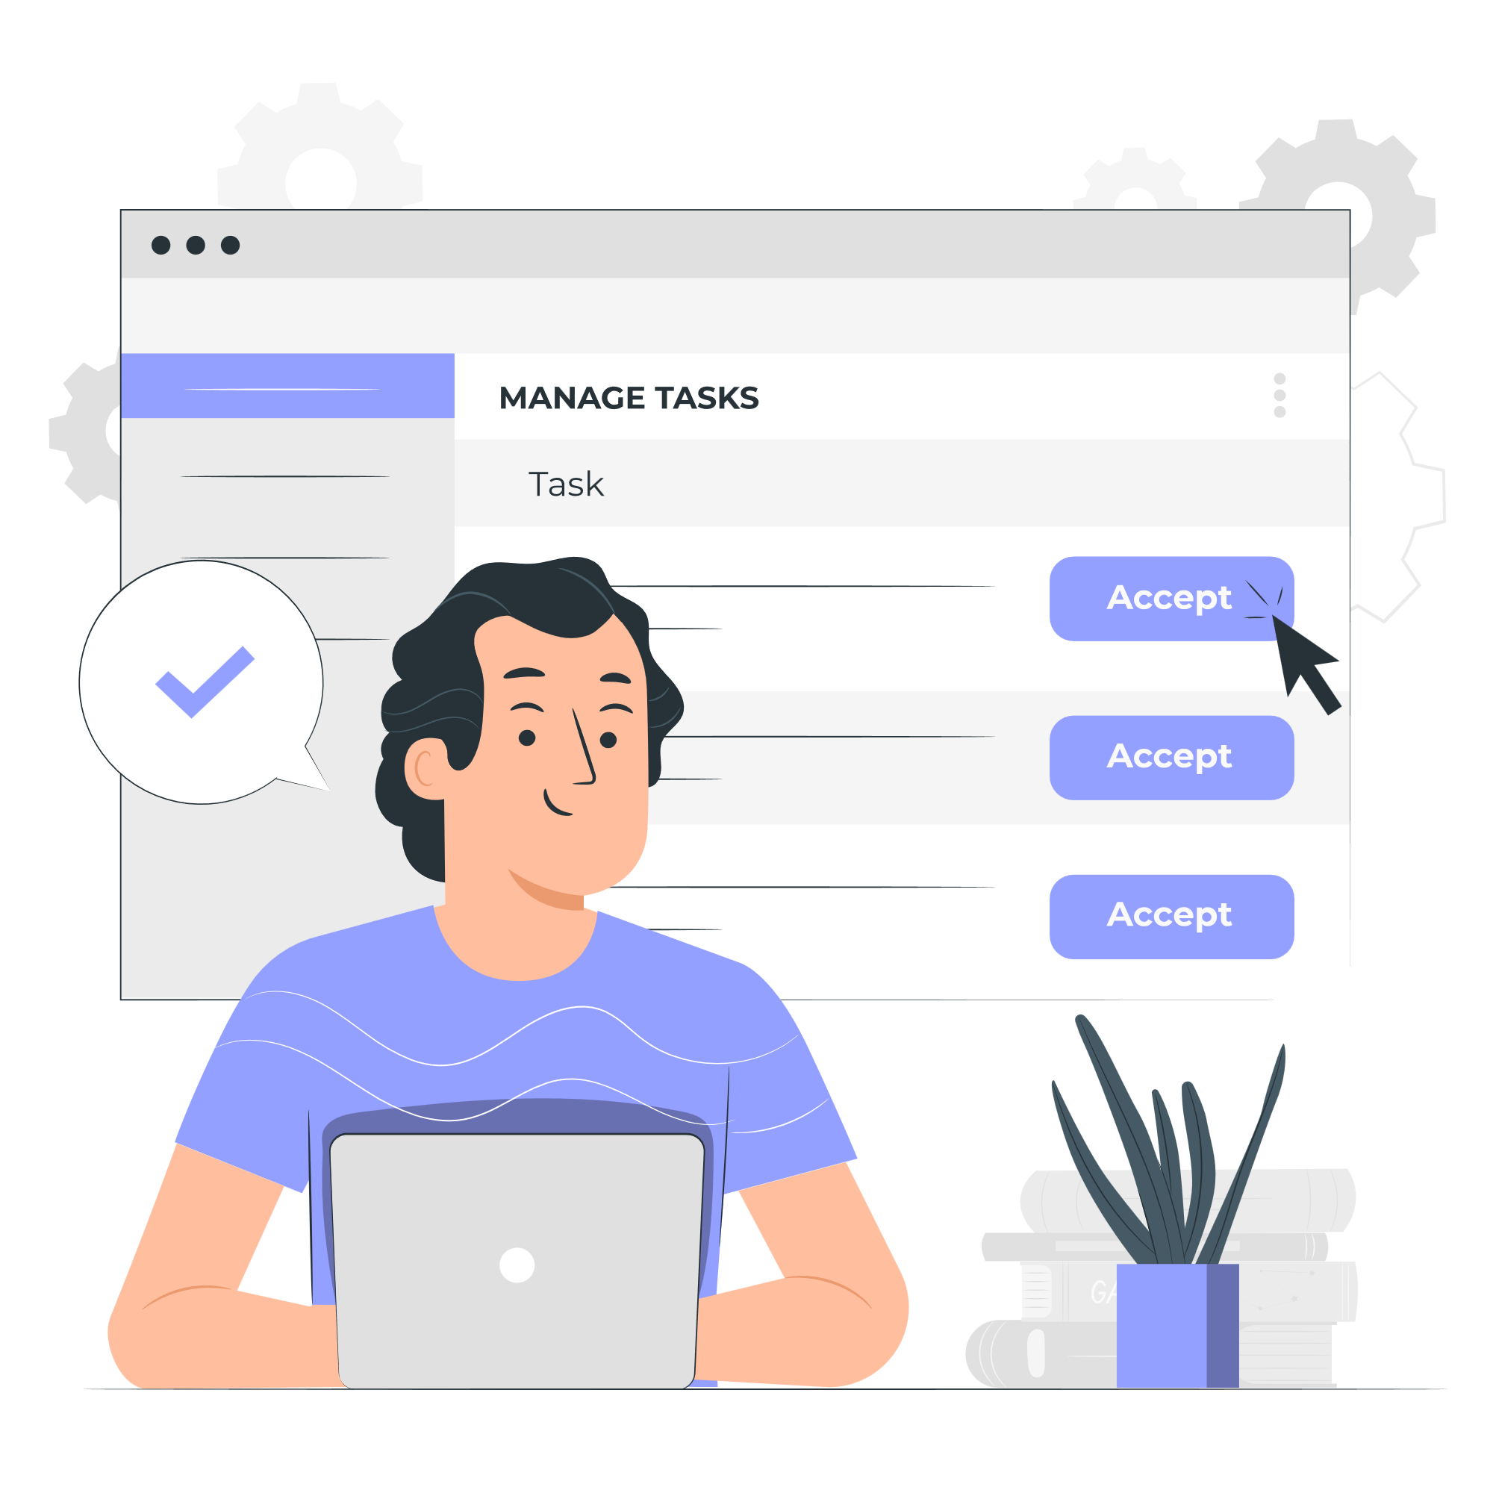
Tasks Perfomed on Academia V2
06

Slide 22

Entry Tasks

Slide 24

Challenges & Solutions
09

Slide 25
Problem vs. Solution
Time Management
Debugging Issues
Observed others and adapted to their pace on tasks assigned
Consulted supervisors, interns ,company engineers and other online sources
01
50 %
50 %
02
04
Learning New Technology
Adaptability
Studied online documentations and other soures
03
I observed others, adapted and gradually met expectations
75 %
60 %

Slide 26

Conclusion
08

Slide 28



